Slide 1




MONDAY
PROJECT
Presented by: Mohammad Khayyo

Slide 2

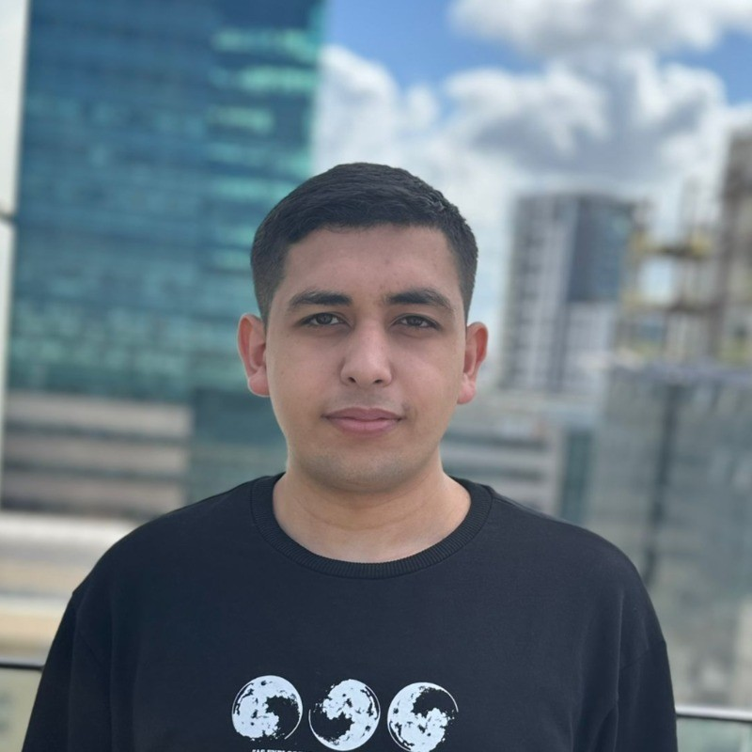
About Me
Software engineering graduate
23 years old
Jerusalem

Slide 3
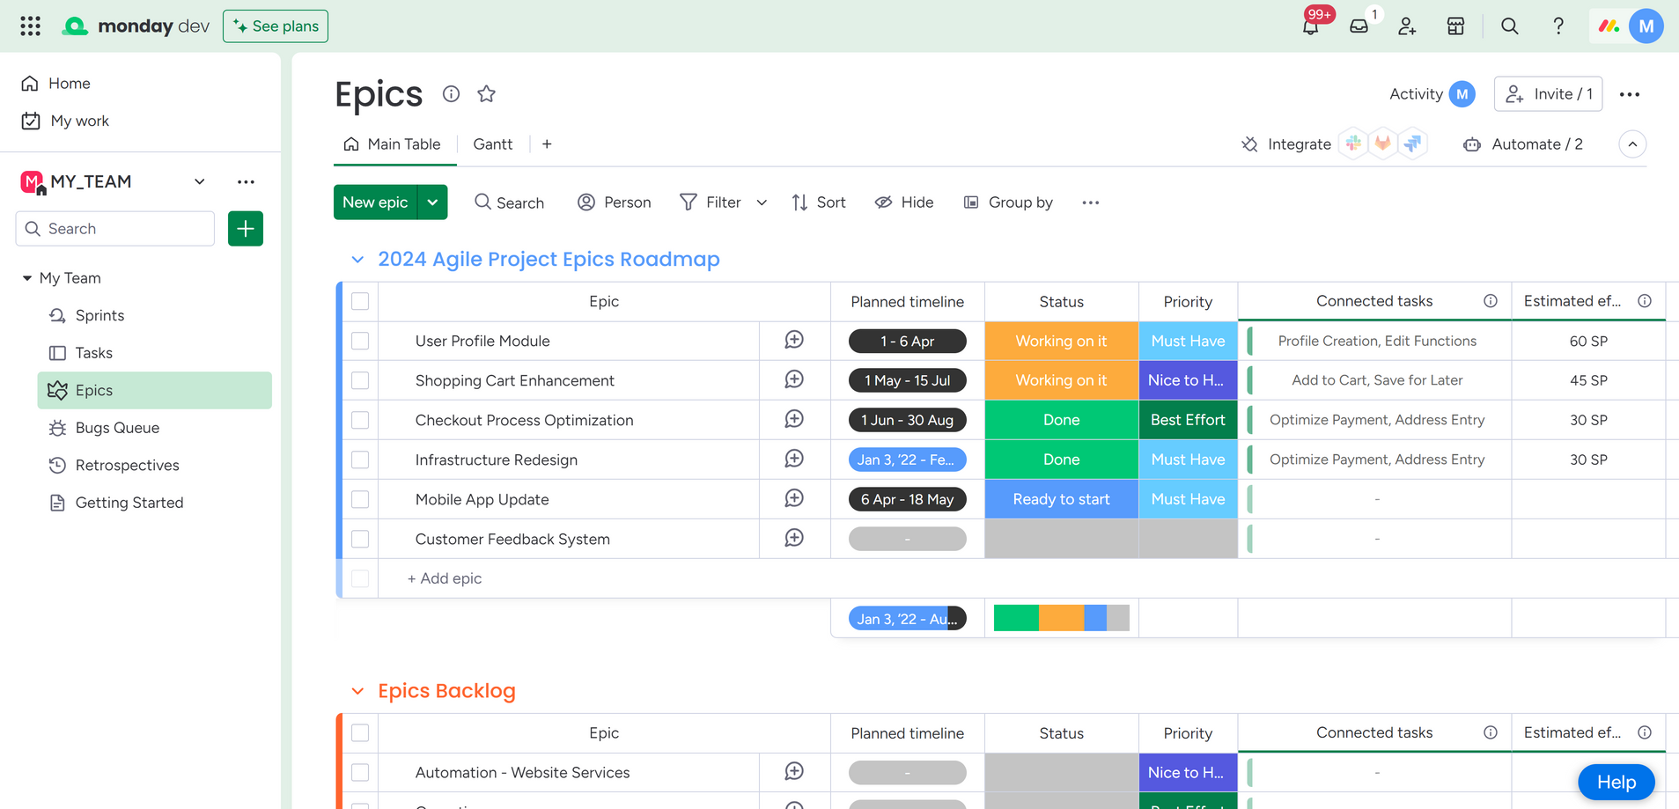
Monday.com

Slide 4

TOOLS
SELENUIM GRID
POSTMAN
JIRA
JENKINS
TESTRAIL
GITHUB
SLACK

Slide 5
STP
Software Test Plan: An overarching guide detailing the testing strategy, timeline, and resources.
STD
Software Test Description: Provides intricate details of each test case, including inputs and expected outcomes.

Slide 6
API Monday
{'error_code': 'ComplexityException',
'status_code': 429,
'error_message': 'Complexity budget exhausted, query cost 300001 budget remaining 9634 out of 1000000 reset in 49 seconds',
'error_data': {},
'errors': ['Complexity budget exhausted, query cost 300001 budget remaining 9634 out of 1000000 reset in 49 seconds'],
'account_id': 22122801}

Slide 7
THE TESTS
API
UI
API & UI
Adding workspaces, boards, groups, etc.
Uploading files.
Adding evaluations.
Editing names and information in the boards.
Adding and editing items.
Searching and filtering.
Navigating between boards and different sections.
Deleting and undoing items.
Uploading a file via the API and verifying its content through the UI.
Adding a link via the API and checking its clickability through the UI.

Slide 8
Bugs
Failed to retrieve the deleted epic using the UNDO button (UI test).
Incorrect status returned for group deletion (API test).

Slide 9
Negative test
Searching for a task that does not exist in the task table.

Slide 10
Non functional test
Capability test:
Running on different browsers using Selenium Grid.
Performance test:
Test how the system behaves under API request load.

Slide 11
QUESTIONS

Slide 12




THANK YOU
For watching this presentation
+972-58-687-6306
mohammadkhayyo@gmail.com
github.com/MohammadKhayyo

